Slide 1
Chandy et al.’s Diffusion Computation Based Algo
Initiate a diffusion computation for a blocked process P_{i}:
send query (i, i, j) to each process P_{j} in the
dependent set DS_{i} of P_{i}; // processes on which Pi is dependent
num_{i} (i) := |DS_{i}|; wait_{i}(i):= true
When a blocked process P_{k} receives a query (i, j, k):
if this is the engaging query for process P_{k} then
send query (i, k, m) to all P_{m} in its dependent set DS_{k};
num_{k}(i) := |DS_{k}|; wait_{k}(i) := true
else if wait_{k}(i) then send a reply (i, k, j) to P_{j}. (assume initiator already got engaging query)
Notes:
Lecture 27 Time13: (assume initiator already got engaging query so if anyone sends a query to the initiator; it will get a reply back

Slide 2
Chandy et al.’s Algo. Contd.
When a process P_{k} receives a reply (i, j, k):
if wait_{k}(i) then begin num_{k} (i) := num_{k}(i) – 1;
if num_{k} (i) = 0
if i = k then declare a deadlock
else send reply (i, k, m) to the process P_{m}which sent the engaging query

Slide 3
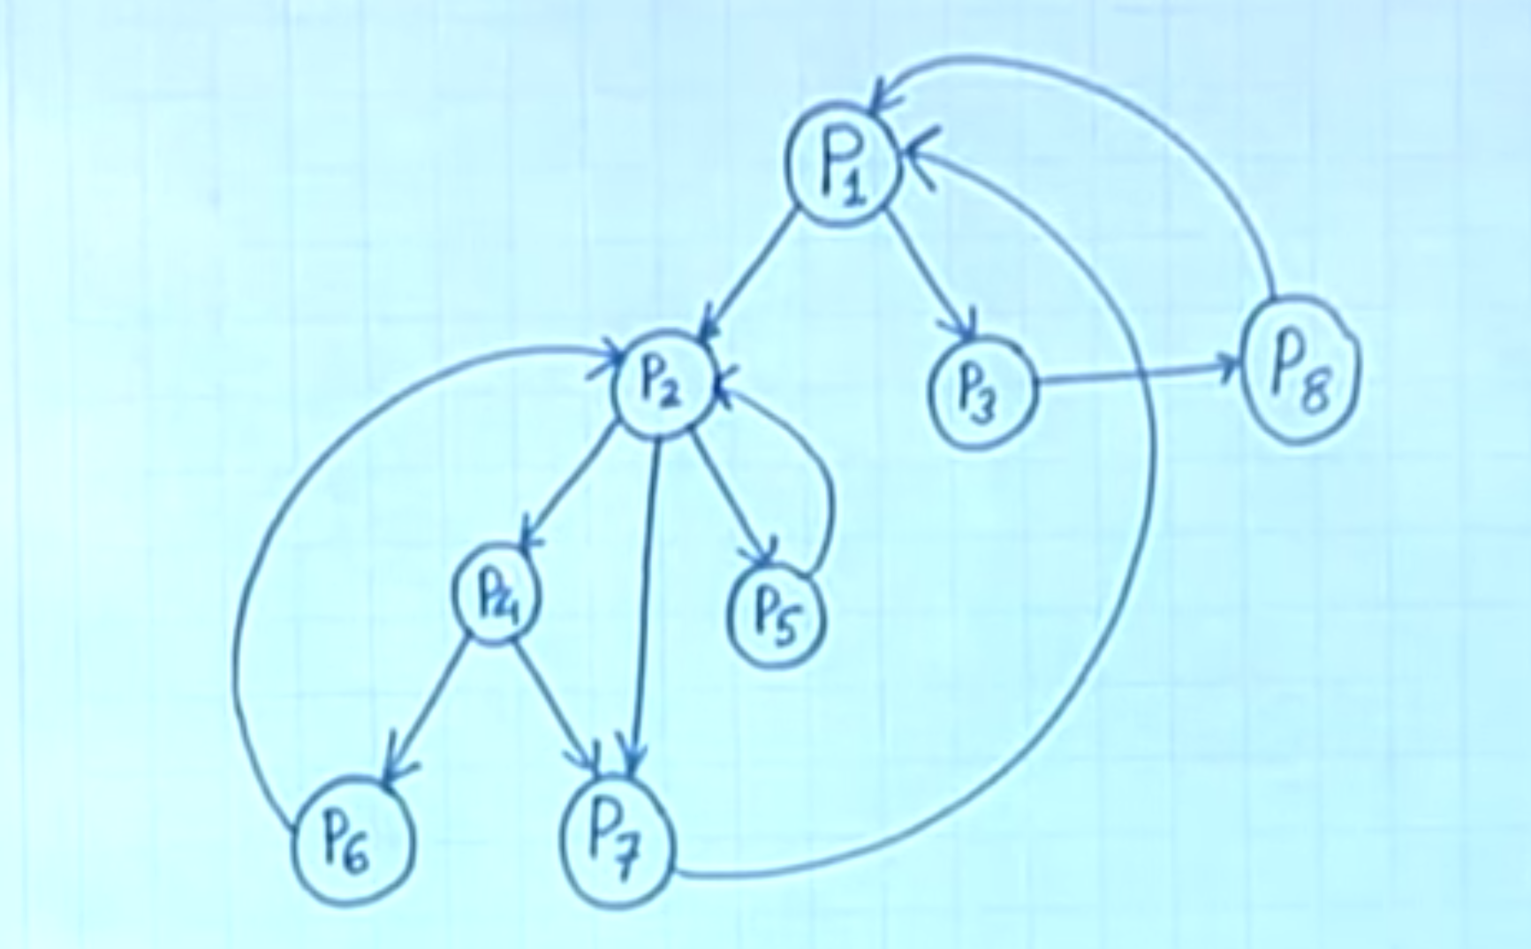
Notes:
Time 26:12

